Slide 1
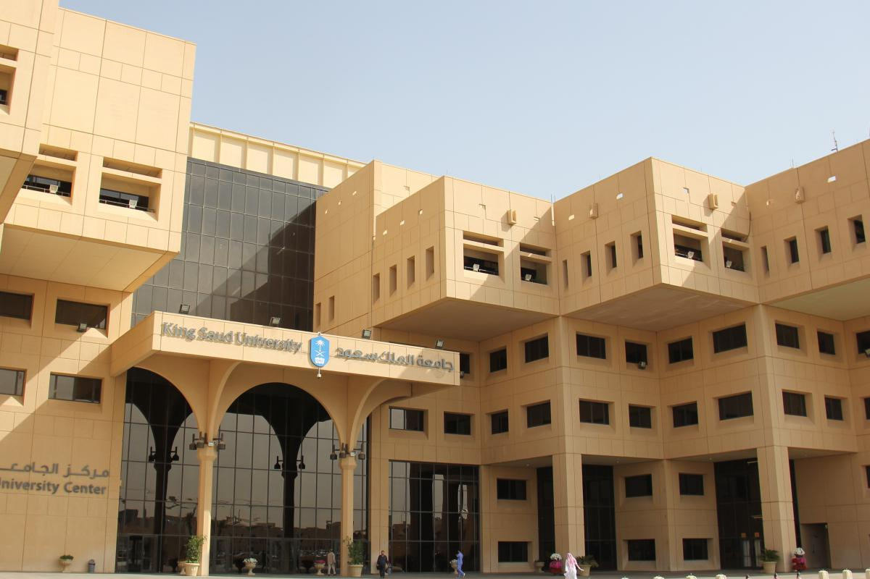
Saud Exports Performance Report
2014 -2018
27 شعبان 1441هـ
19 ابريل 2020م
Note: Some differences in totals or percentages might be found due to rounding numbers.
1

Slide 2
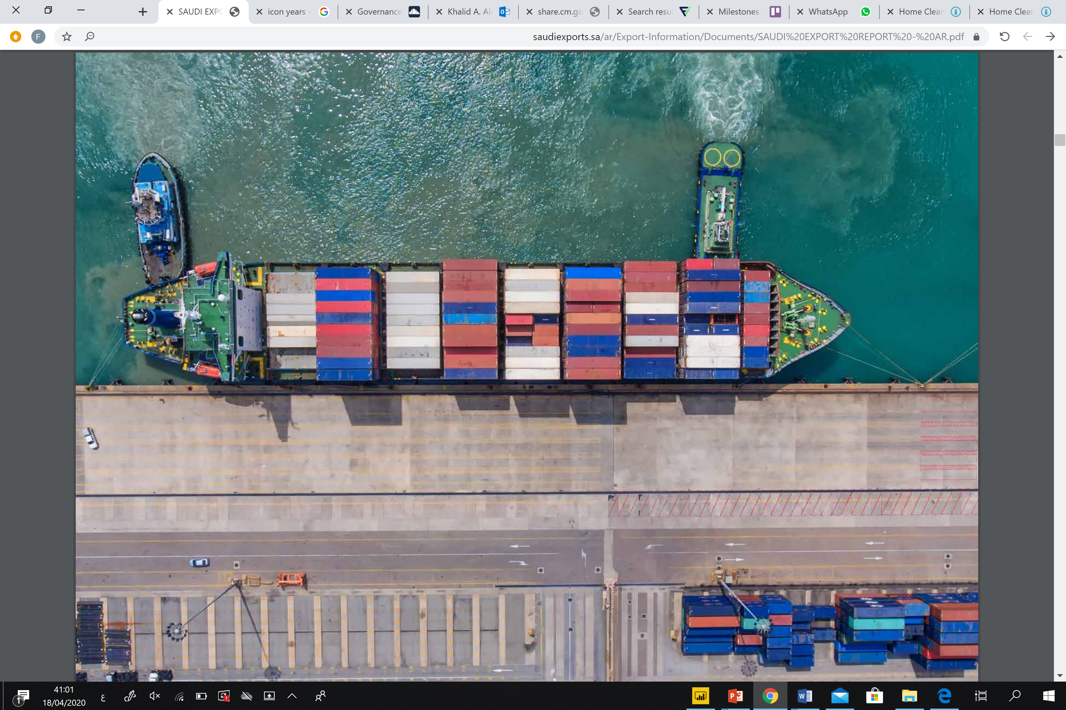
Fahad Abalkhail
438104130
Fahad Almalki
438105865
Bassam Alfarhood
437103967
Fahad Alaiban
438100455
Abdulrahman Almishari
438104076
Coordinator :NAIF ALMUTAWA
Saud Exports Performance Report
2

Slide 3



Goal
This report presents development in merchandise exports of the Kingdom of Saudi Arabia for the period (2014 -2018)
Brief
The merchandise exports of Saudi Arabia amounted to 176,900,697,626 riyals in (2014) as compared to 99,790,378,128 riyals in the corresponding period of (2015). Also the merchandise exports in 2016 were lower than those by 94,908,908,009 riyals.
Resource
The legal source of information provided by Saudi Open Data Portal (https://www.data.gov.sa/en/home)
3

Slide 4


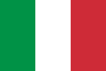
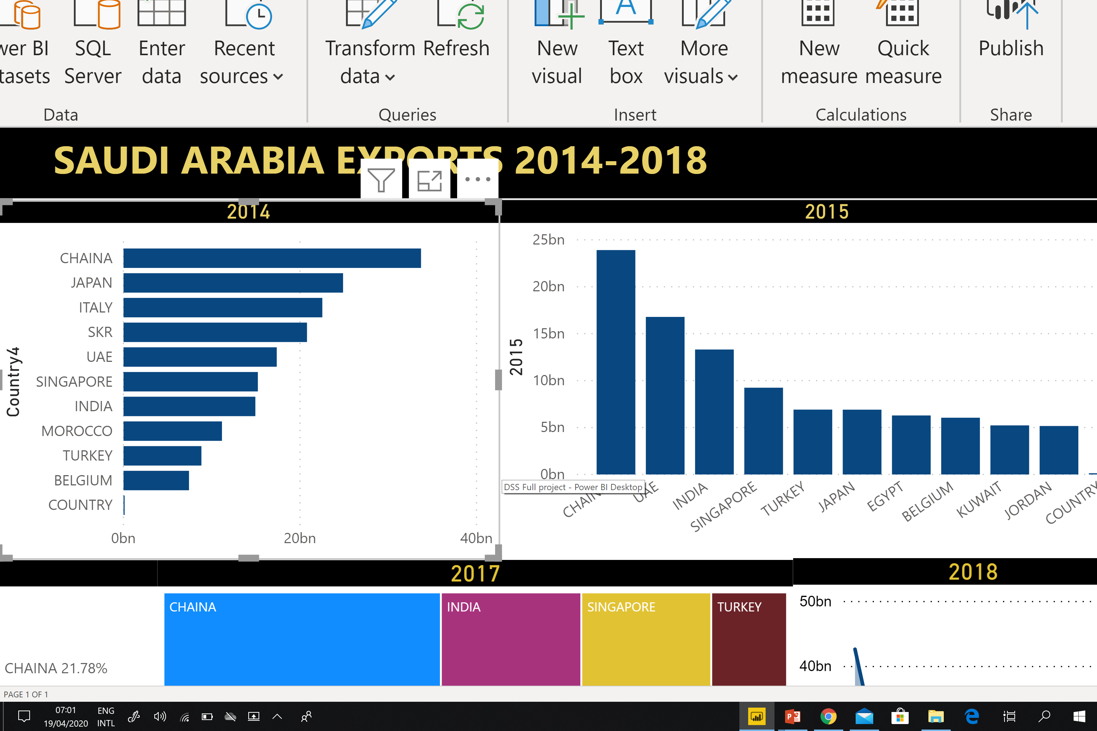
19%
14%
13%
2014
The value of the Kingdom's merchandise exports during the year 2014 reached (176,9) billion SAR . The most important countries to which the Kingdom was exported this year was China , which was taking the first position with a value of (33.7) billon SAR at a rate of (19%) of the total export value with an increase of than the previous year. In the second position was Japan by (24.88) billion SAR at a rate of (14.8%) of the total exports. Chart1.
Chart 1
4

Slide 5
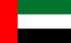
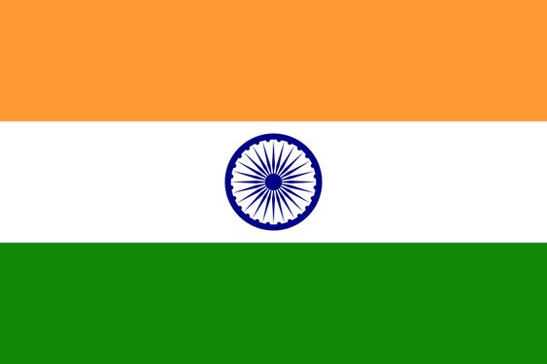
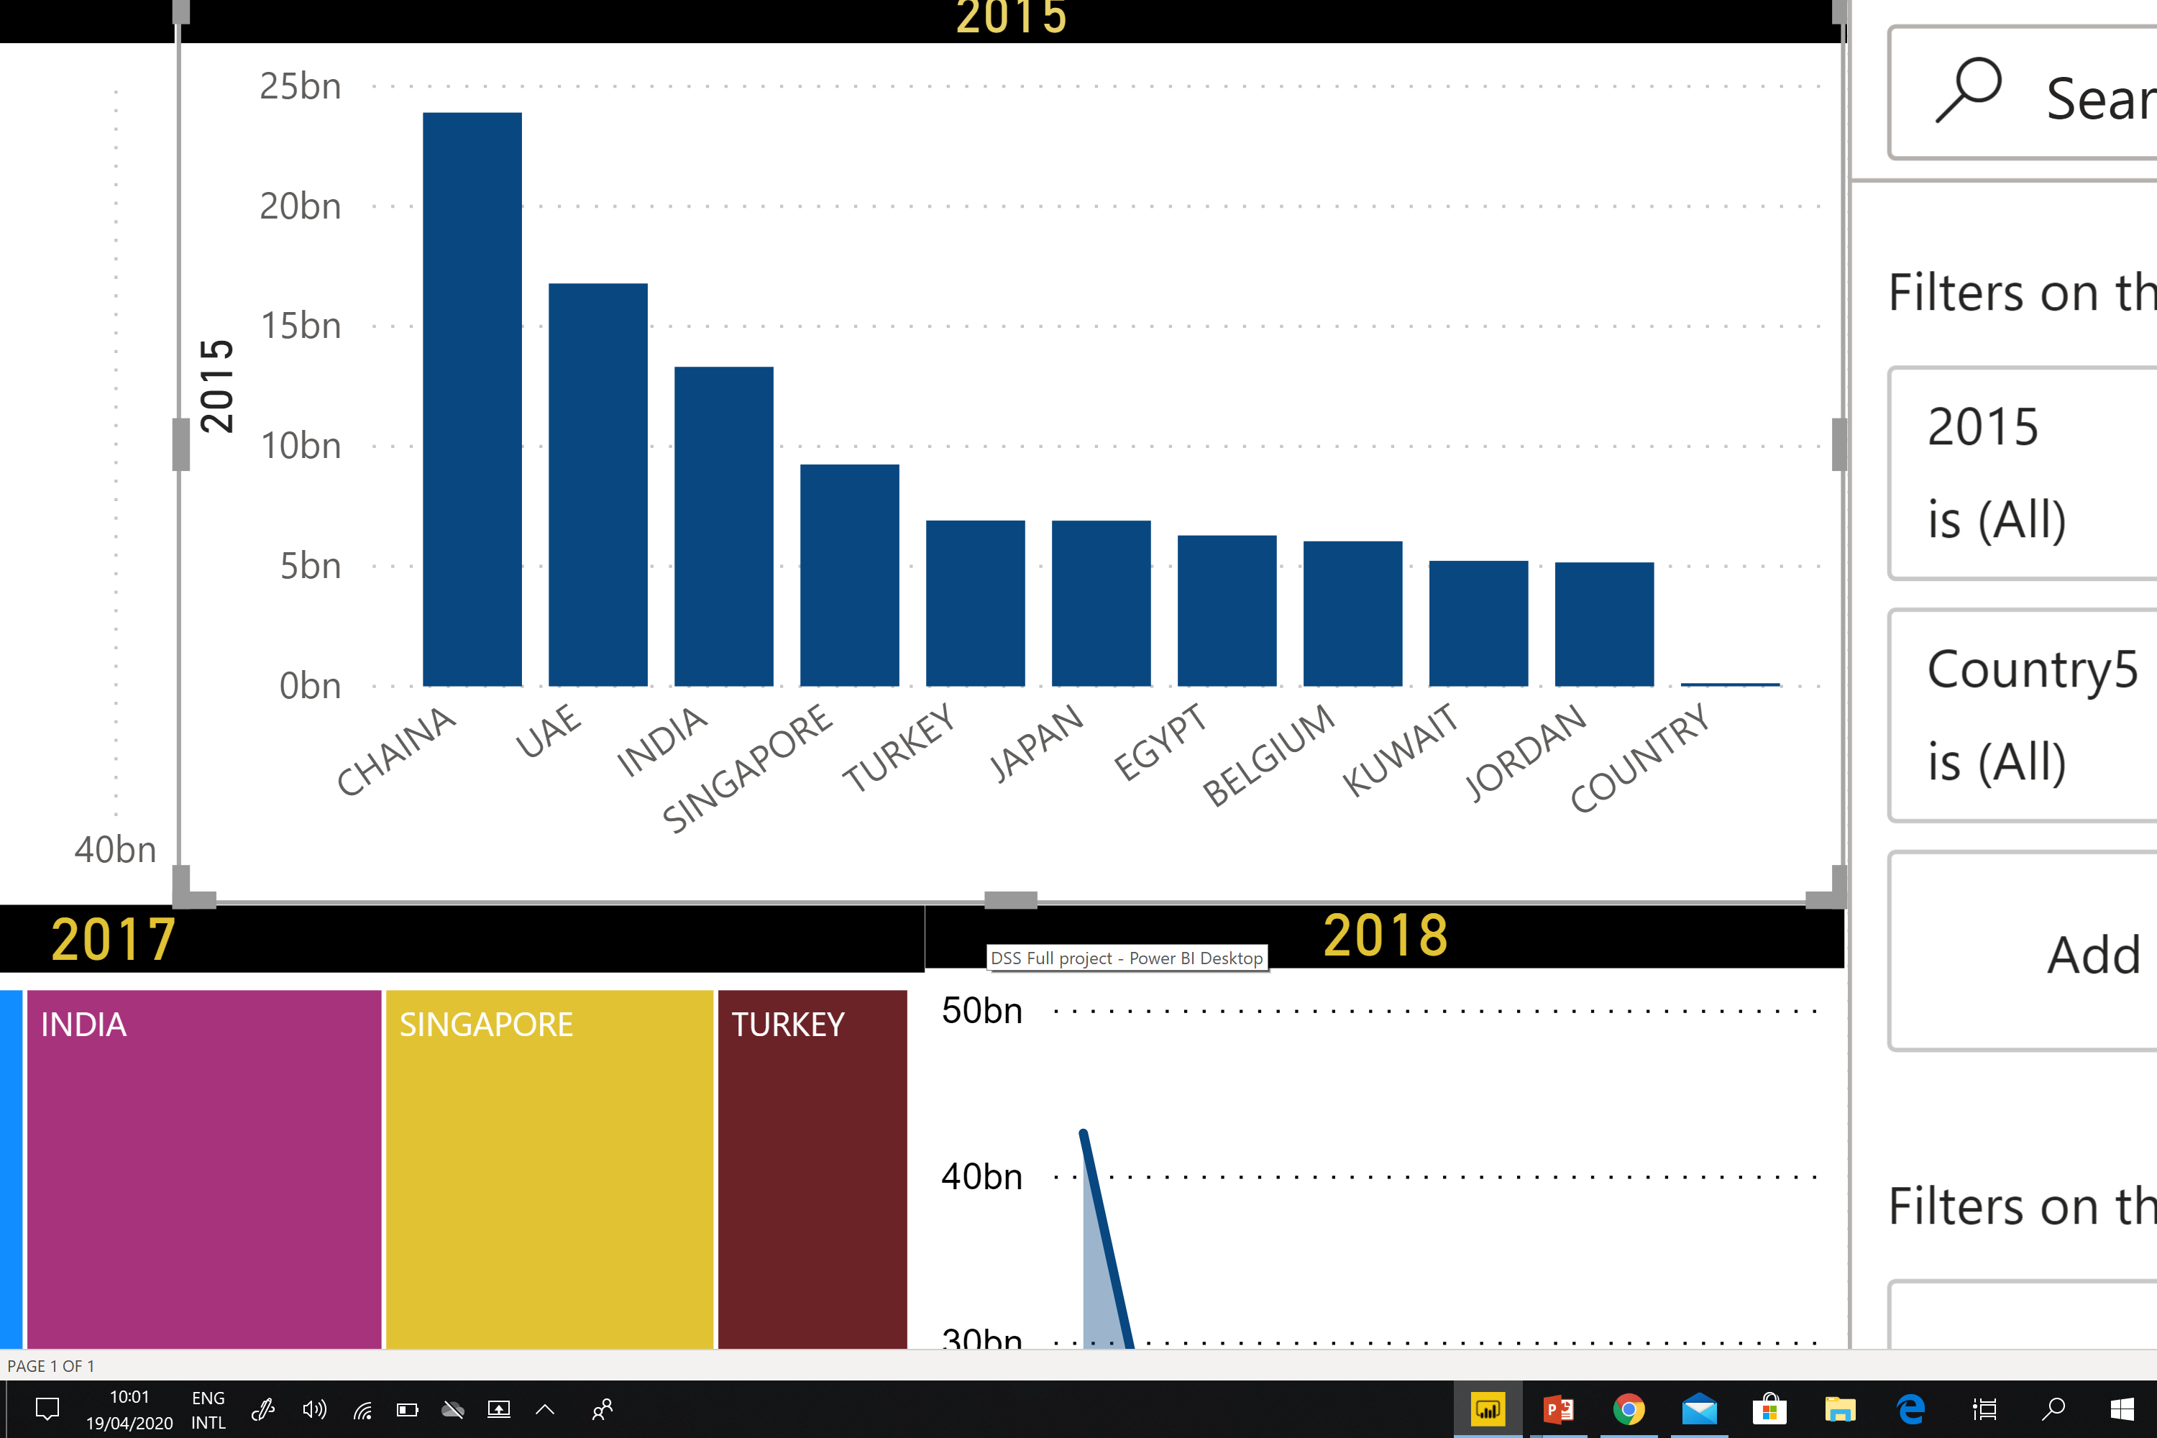
23,9 Billon SAR
16.7 Billon SAR
13.3 Billon SAR
2015
Chart 2
5
Notes:
The value of the Kingdom's merchandise exports during the year 2015 amounted to (99,7) billion, compared to (176,9) billion in 2014. With a decrease of (77,2) billion (43,6%) which is showing significantly changed And the value of Chania is taking number 1 and the lead of the most value in the world

Slide 6

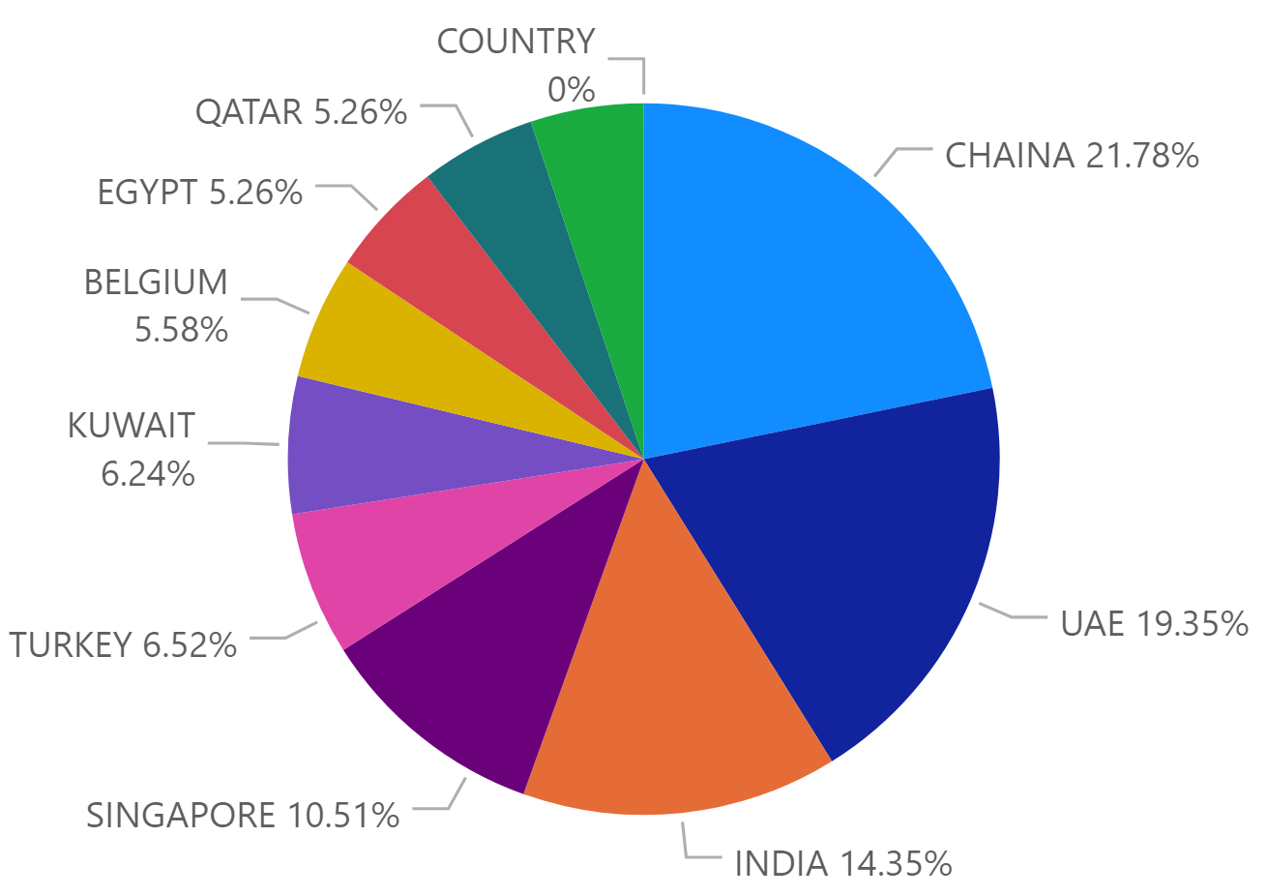
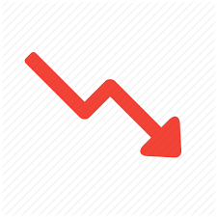
2016
UAE
China
Chart 3
6
Notes:
The value of the Kingdom's merchandise exports during the year 2016 reached (94,9) billion SAR, compared to (99,7) billion SAR in 2015,
With a decrease of (4.8) billion SAR, (4.81%) . The value of oil exports reached the lowest value in 2016

Slide 7
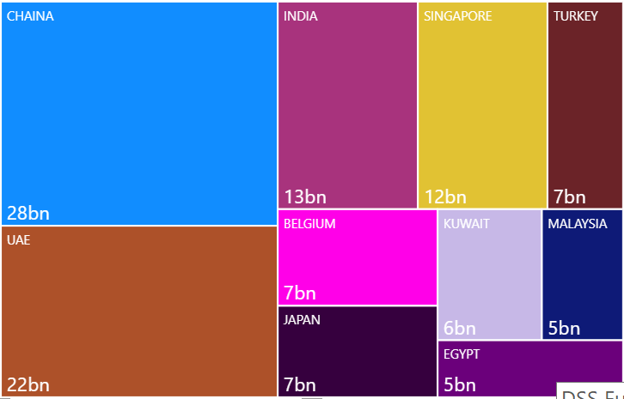
2017
Chart 4
7
Notes:
The value of the Kingdom's merchandise exports during the year 2017 reached (111.5) billion SAR . The most important countries to which the Kingdom was exported this year was China , which
was taking the first position with a value of (28.1) billon SAR at a rate of (25%) of the total export value with an increase of than the previous year. In the second position was Japan by (24.88) billion SAR at a rate of (14.8%) of the total exports. Chart1.

Slide 8
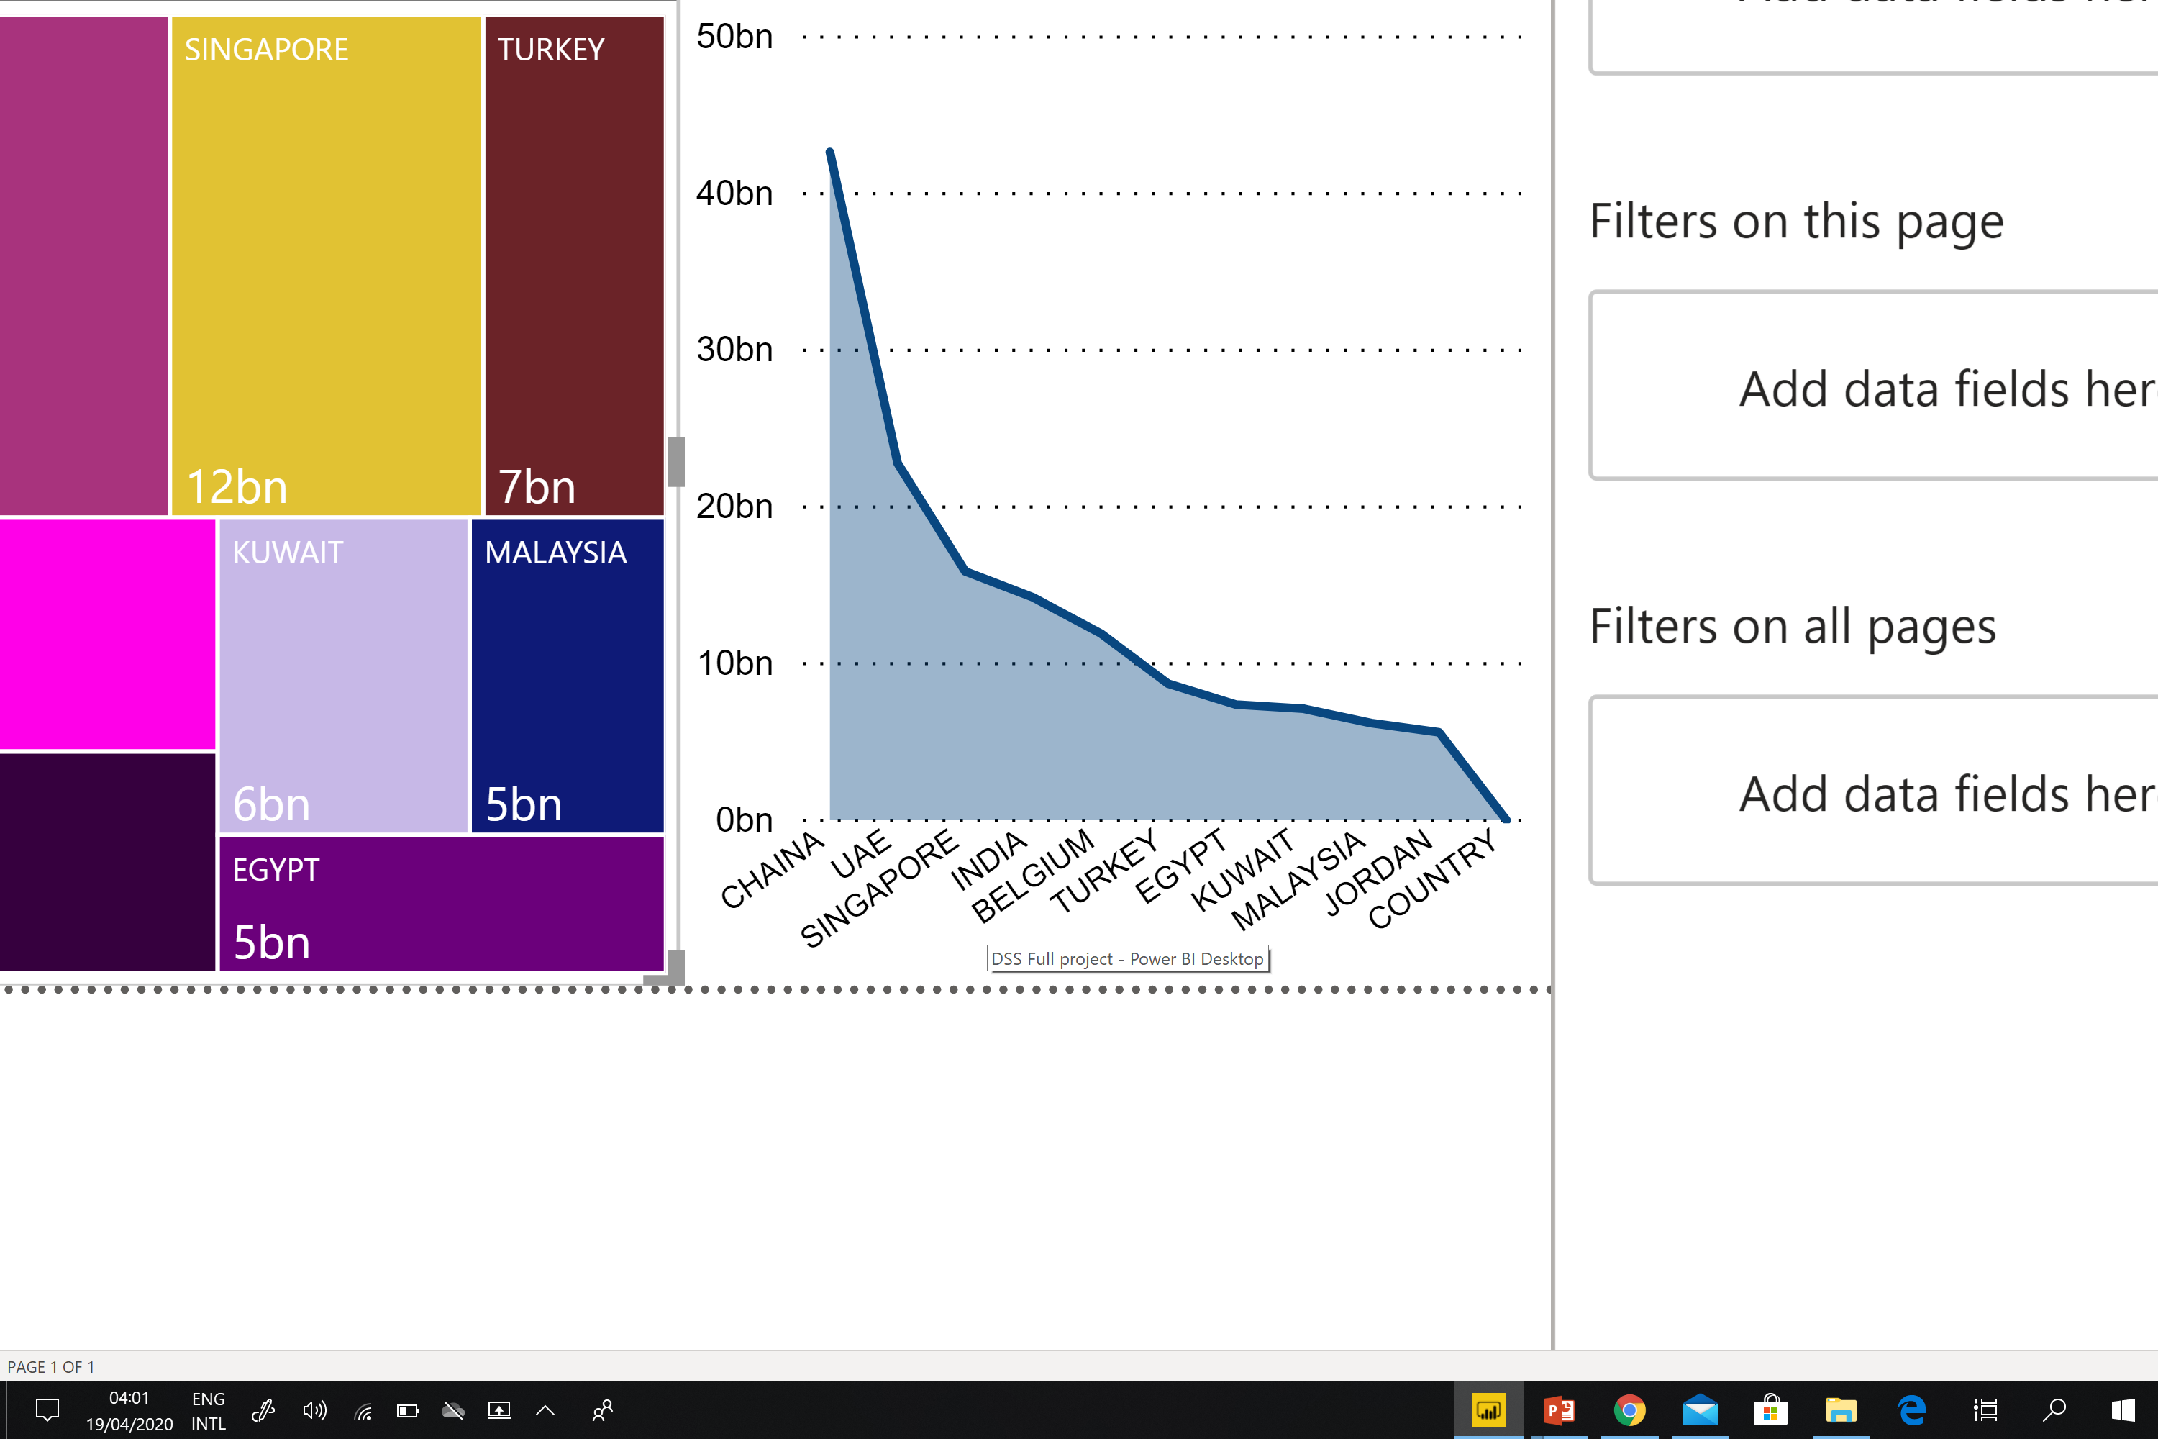
2018
The value of merchandise exports amounted to (142,5) billion In 2018, compared to (111,5) billion, in 2017 with an increase of (31) billion , rate (27.8%) over the previous year. Non-oil exports in 2018 reached their highest levels , The highest value was plastics, rubber and articles. Chart5.
Chart 5
8
Notes:
The value of merchandise exports amounted to (142,5) billion SAR In 2018, compared to (111,5) billion SAR, in 2017 with an increase of (31) billion SAR , rate (27.8%) over the previous year. Non-oil exports in 2018 reached their highest levels , The highest value was plastics and rubber and articles thereof .

Slide 9
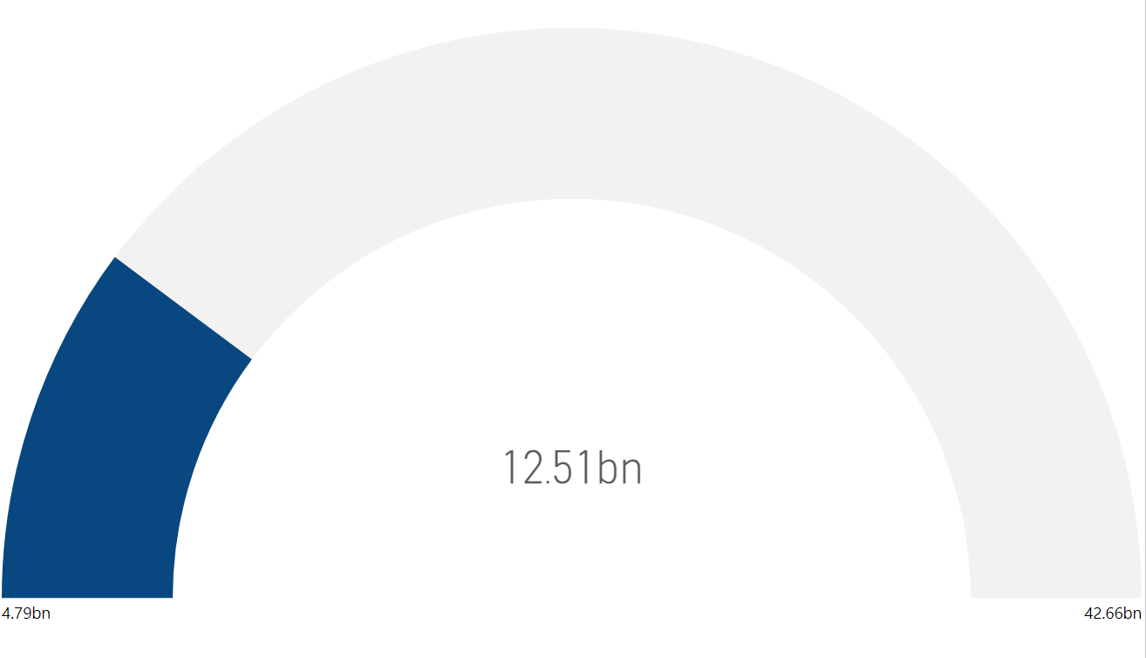
Exports in Saudi Arabia decreased to 99.8 Billion SAR in 2015 from 176.9 Billion SAR in 2104.
Saudi Arabia's economy is highly dependent on oil exports (87 percent of total exports) and the state-owned firm Aramco is the world's largest oil producing and exporting company. Main export partners are: China, Japan, South Korea and India. Others include: United Arab Emirates, Singapore and Italy. Chart6.
Chart 6
9

Slide 10
TOTAL
2014 : 1,283.6 billion‬
2015 :
(763) billion : exports
(573) billion : Petroleum exports
(190) billion : Non-oil exports
2016 :
(688.4) billion : exports
(7,510) billion : Petroleum exports
(7,177) billion : Non-oil exports
2017 :
(827.8) billion : exports
(638.4) billion : Petroleum exports
(193.4) billion : Non-oil exports
2018 :
(1,104) billion : exports
(868.4) billion : Petroleum exports
(235.4) billion : Non-oil exports
10

Slide 11
